Slide 1


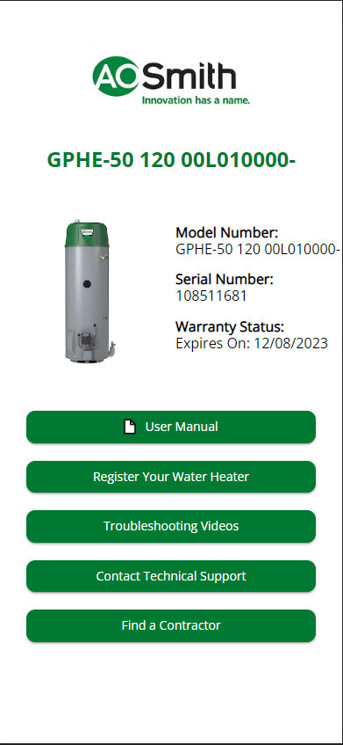
QR Code Scanner
Registration, Self-help, Technical Support and More

Slide 2
A.O. Smith
01
We help you get easy access to information specific to your product, and help you solve problems without needing to call technical support.
QR Code Web app. No Download Required.
02
You fill out your contact info, and we will skip that part on the phone. Saving you time if customer support is needed.
Point your camera at the code, tap the link. Open the mobile web app.
03
The most common information is available without calling or searching the website. Content is dynamic based on availability.

Slide 3
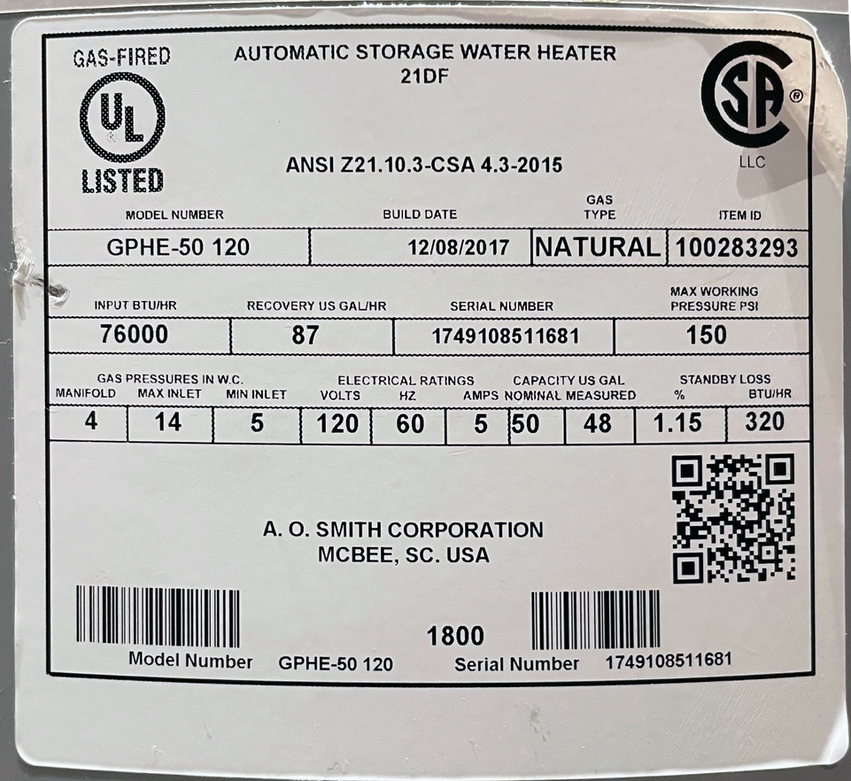

A.O. Smith
How it works
Scan the QR code on our product.
Product Specific info and tools.
In Warranty Case Creation
Open your camera app on iOS or Android and scan the QR Code on the rating plate.
At a glance see the warranty Status, and links to Registration, Troubleshooting, Technical Support, Contractor or Service Parts
Using a Prefilled serial from the scan, the user can fill out the relevant issue, saving time with the agent on the phone.

Slide 4
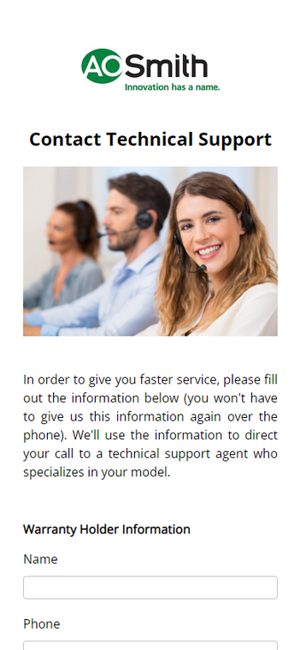
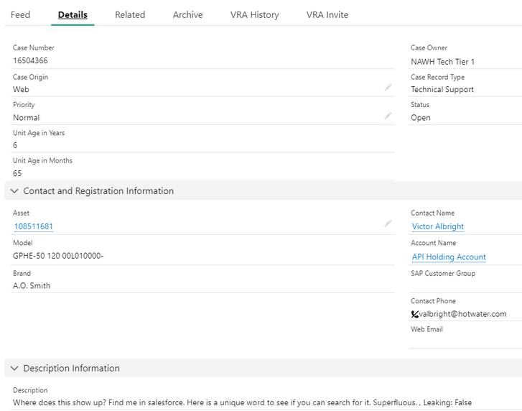
A.O. Smith
Support in 1,2,3.
  Fill Out
2. Submit
3. Behind the scenes

Slide 5

A.O. Smith
01
This project is built to centralize existing tools and product-specific information in one place. Over time, more tools and information will be added.
Summary
02
Scan the QR code on the rating plate of any of our heaters to load the web app.
03
We are launching with Model Info, Warranty Status, Registration, Troubleshooting Videos, Technical Support Case Creation, and Contractor / Retail Locator

